Slide 1
Ocean Liner Tycoon
Lycia Stenson

Slide 2
What is Ocean Liner Tycoon?

Slide 3
What is Ocean Liner Tycoon?
Ocean Liner Tycoon is a mobile tycoon game.
Tycoons are a very popular genre in the mobile market.
Players build a fleet of ocean liners, with the ability to customise the design and structure of each ship.
Players then manage their fleet, taking passengers on voyages.

Slide 4
The Gameplay Loop
Design Ship
Voyages
Profit
Upgrades
Players design a ship for their ocean liner fleet, customising the shape of the hull and superstructure, and designing interior spaces.
Voyages can be viewed on a world map. Ships automatically make voyages but the player can also micromanage and control the ship.
The player profits in-game currency from voyages, the amount depending on how much the passengers enjoyed their time and the facilities.
The in-game currency can be spent to upgrade ship technology and entertainment, and to build new ships.

Slide 5
Cutaway Rooms
During both the ship building and micromanage stages of the game, when the player zooms in the perspective closer, the rooms will be displayed with a cutaway effect like that of The Sims.
Image Credit: https://www.washingtonpost.com/technology/interactive/2024/the-sims-players-real-life-video-games/

Slide 6
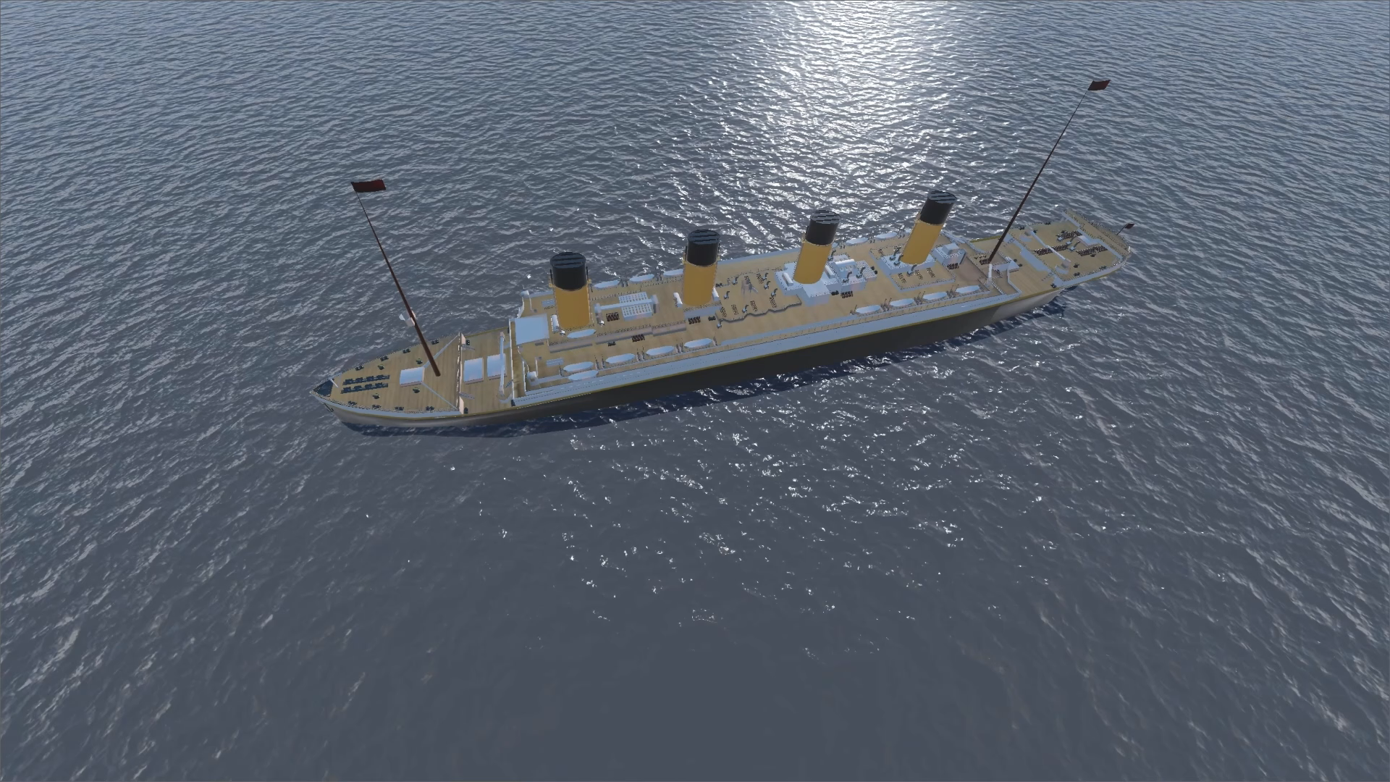
Graphics and Mechanics are not representative of final product. Early demonstration only.

Slide 7


‘Our friend Mike Brady from Oceanliner Designs’
Mike Brady runs the popular YouTube channel Oceanliner Designs. Sponsoring his content will allow the game to reach a large audience of maritime enthusiasts.

Slide 8
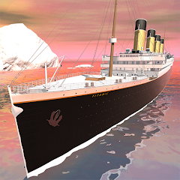


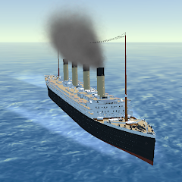
Competitors What’s different about Ocean Liner Tycoon?
Idle Titanic Tycoon: Ship Game
Stormworks: Build and Rescue
The player captains the Titanic. As a tycoon game it shares some similarities with our game but lacks ship building mechanics.
Players can build and pilot vehicles including ships.
Ship Simulator: Boat Game
Ocean Liner Simulator
Jupiter is the biggest planet of them all
Saturn is a gas giant and has several rings

Slide 9
The Team
Lycia Stenson
Todd Clark
Ophelia O’Melia
Project Lead
Lead Programmer
Lead Designer
Lead Artist
Lisa Curtis
Melissa Curtis
Jupiter
Technical Designer
Programmer
Artist
Jupiter is the biggest planet of them all

Slide 10
Ocean Liner Tycoon
Do you have any questions?
lycia@oceanlinertycoon.com
oceanlinertycoon.com
Please keep this slide for attribution

Slide 11


Slide 12
The Gameplay Loop
Design a ship
Voyages
Spend profit
Players design a ship for their ocean liner fleet, customising the shape and designing the interior spaces.
Ships automatically and continuously make voyages, and can be viewed on a world map. Interacting with the ship to manage the voyage more directly.
Spend the profit of the voyage to upgrade the ship, and eventually build bigger ships

Slide 13
- Whoa! -
This can be the part of the presentation where you introduce yourself, write your email…

Slide 14
01
Introduction
You can enter a subtitle here if you need it

Slide 15
Context and background
Mercury
Venus
Mercury is the closest planet to the Sun and the smallest one in the Solar System—it’s only a bit larger than the Moon
Venus has a beautiful name and is the second planet from the Sun. It’s hot and has a poisonous atmosphere

Slide 16
Presidential reconstruction
Andrew Johnson
Thaddeus Stevens
You can write the description here
You can write the description here
You can write the description here
You can write the description here
You can write the description here
You can write the description here
You can write the description here
You can write the description here
You can write the description here
You can write the description here
You can write the description here
You can write the description here

Slide 17
—Someone Famous
“This is a quote, words full of wisdom that someone important said and can make the reader get inspired”

Slide 18

A picture is worth a thousand words

Slide 19
Comparison
Aspects | Reconstruction Era | Gilded Age
Time period | 1865-1877 | 1877-1900
Post-war conditions | Devastation from the Civil War, Southern Reconstruction | Rapid industrialization and economic growth
Focus | Rebuilding and integrating Southern states | Economic expansion, technological advancements, and urbanization
Civil rights | Emphasis on African American civil rights | Expansion of civil rights issues, including labor and women's rights

Slide 20
98,300,000
Big numbers catch your audience’s attention

Slide 21
9h 55m 23s
333,000
386,000 km
Jupiter's rotation period
The Sun’s mass compared to Earth’s
Distance between Earth and the Moon

Slide 22
Workforce distribution in the Gilded Age
25%
50%
75%
Industrial workers
Agrarian workers
Service sector
Mercury is the closest planet to the Sun and the smallest of them all
Despite being red, Mars is actually a cold place. It’s full of iron oxide dust
Venus has a beautiful name and is the second planet from the Sun

Slide 23
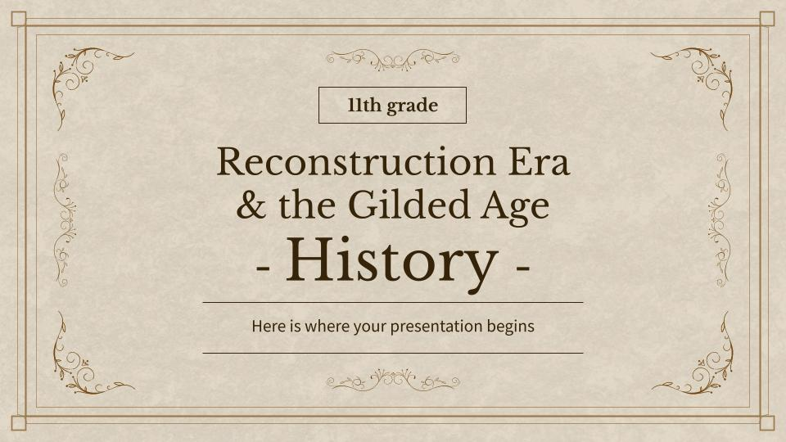
Computer mockup
You can replace the image on the screen with your own work. Just right-click on it and select “Replace image”

Slide 24
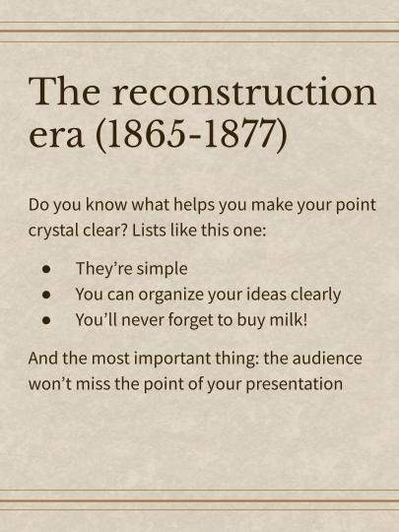
Tablet mockup
You can replace the image on the screen with your own work. Just right-click on it and select “Replace image”

Slide 25
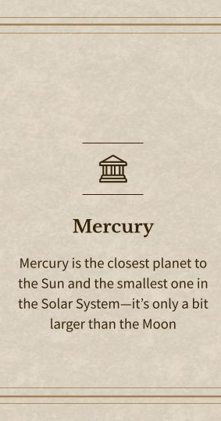
Phone mockup
You can replace the image on the screen with your own work. Just right-click on it and select “Replace image”

Slide 26
The Gilded Age: 1870-1900
Industrialization & urbanization
Ranching, mining & farming
Reconstruction & rise of Jim Crow segregation

Slide 27
The key aspects
Reconstruction Era
Gilded Age
Rebuilding states
Limited economic
Economic growth
Economic expansion
Neptune is far away from Earth
Mercury is the closest planet to the Sun
Venus is the second planet from the Sun
Jupiter is the biggest planet of them all

Slide 28
Reconstruction amendments
Amendment | Description | Ratification Date
13th Amendment | Abolished slavery and involuntary servitude in the United States, except as punishment for a crime | December 6, 1865
14th Amendment | Granted citizenship to all persons born or naturalized in the United States, including former slaves, and guaranteed equal protection under the law | July 9, 1868
15th Amendment | Prohibited the denial of voting rights based on race, color, or previous condition of servitude. It aimed to protect the voting rights of African American men | February 3, 1870

Slide 29
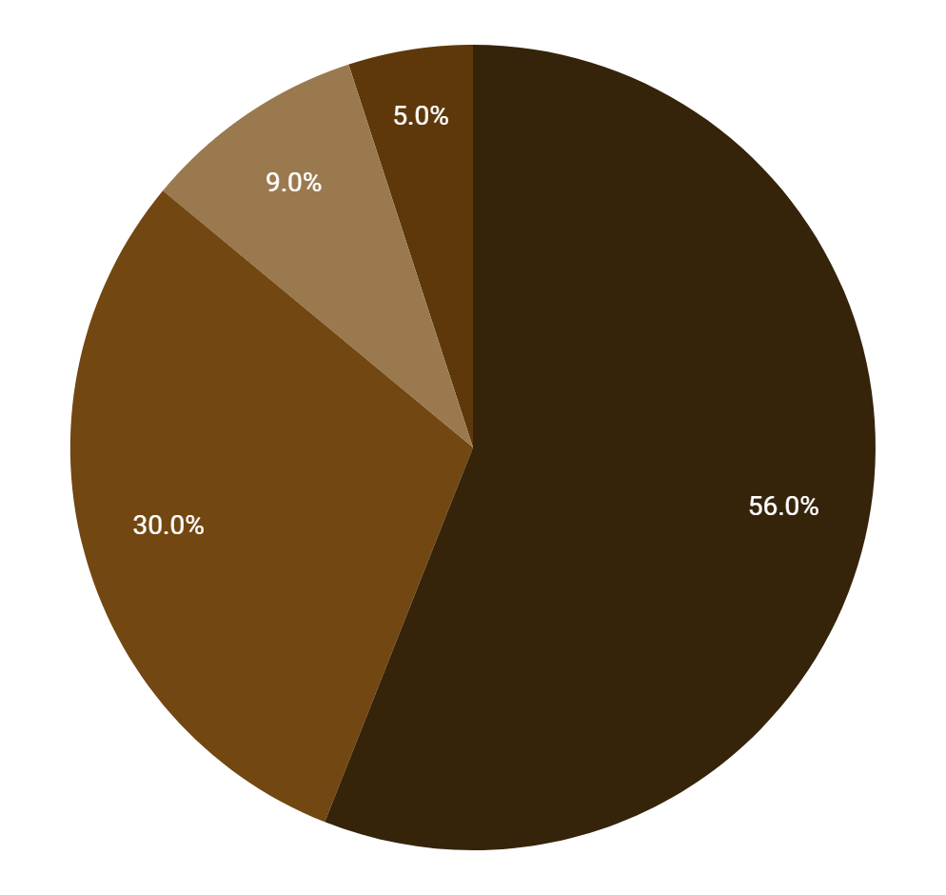
Immigration to the US, 1871 -1920
North Central Europe
The Americans
Southern Europe
Asia and others
Mercury is the smallest planet
Venus is the second planet from the Sun
Jupiter is the biggest planet
Saturn is a gas giant with rings
Follow the link in the graph to modify its data and then paste the new one here. For more info, click here

Slide 30
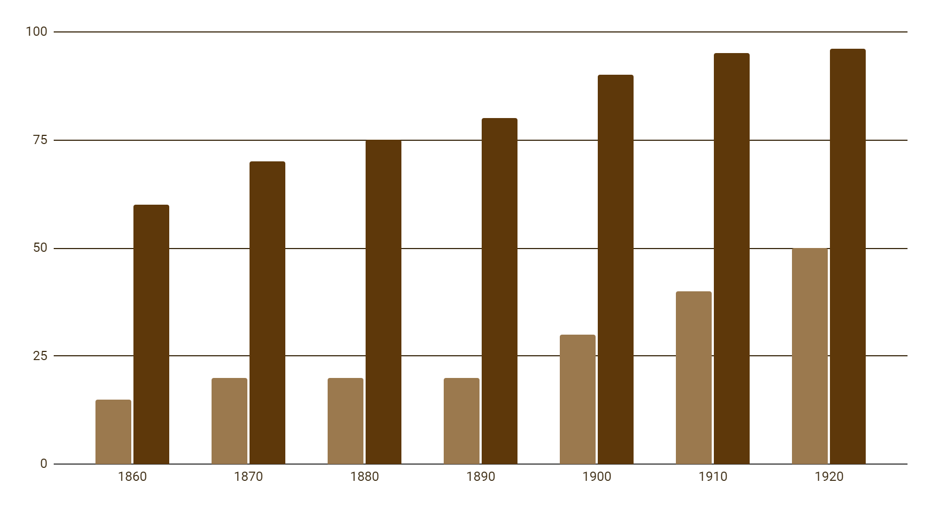
American become urbanized
Urban
Rural
Venus is the second planet from the Sun
Saturn is a gas giant with rings
Follow the link in the graph to modify its data and then paste the new one here. For more info, click here

Slide 31
Exercise 1: Answer this questions
What was the purpose of the Freedmen's Bureau?
You can answer here
What characterized the Gilded Age?
You can answer here
What did the Sherman Antitrust Act aim to do?
You can answer here

Slide 32
Exercise 2: True or False
Instructions: Mark the statement below by filling in the True (T) box if it is true, False (F) if you feel the statement is not correct
No. | Sentences | True | False
1 | The 13th Amendment to the United States Constitution abolished slavery | … | …
2 | The Panic of 1873 led to a severe economic depression in the United States | … | …
3 | The Reconstruction Era followed the American Civil War | … | …

Slide 33
Exercise 3: Multiple choice
Instructions: Choose the most appropriate answer from the provided options (a, b, c, or d) by placing a square shape to the correct answer
Which period immediately followed the Reconstruction Era?
A | Progressive Era | C | Colonial Era
B | Gilded Age | D | Civil Rights Movement

Slide 34
Exercise 4: Fill in the blank
Instructions: Identify the missing word(s) that complete(s) the sentence. Write your answer in the space provided
1 | The Reconstruction Era followed the | …
2 | The 13th Amendment | … | slavery
3 | The Gilded Age was characterized by political | … | and social inequality
4 | Plessy v. Ferguson upheld racial segregation under the | … | doctrine

Slide 35

Our team
Sofia Hill
Kaliyah Harris
You can speak a bit about this person here
You can speak a bit about this person here

Slide 36
Alternative resources
Here’s an assortment of alternative resources whose style fits the one of this template:
Vectors
Realistic silver frame template
Golden frame template

Slide 37
Resources
Did you like the resources on this template? Get them for free at our other websites:
Vectors
Barbershop invoice template with grainy retro texture
Realistic golden frame design
Photos
Festive independence day composition
Facade beautiful historic building
Pirate artifacts arrangement still life
Portrait volunteers who organized donations charity

Slide 38
Contents of this template
You can delete this slide when you’re done editing the presentation
Fonts | To view this template correctly in PowerPoint, download and install the fonts we used
Used and alternative resources | An assortment of graphic resources that are suitable for use in this presentation
Thanks slide | You must keep it so that proper credits for our design are given
Colors | All the colors used in this presentation
Icons and Infographic resources | These can be used in the template, and their size and color can be edited
Editable presentation theme | You can edit the master slides easily. For more info, click here
For more info: SLIDESGO | BLOG | FAQs
You can visit our sister projects: FREEPIK | FLATICON | STORYSET | WEPIK | VIDEVO

